Slide 1
Introduction to Sound Design in Processing
Project Ignite Workshop #3

Slide 2
Object-Oriented Programming
We can create objects that belong to a class. All objects of a class share common properties and functions
Example: consider a class called “vehicle”. What properties would we want to define for an object that belongs to the vehicle class? What actions, or functions, would we want to perform with the vehicle class?
To create a new object, we use a declaration of the following form:
className objectName = new className(parameters, for, class);
When we create a new instance of an object for a class, we need to pass certain parameters to the class. What parameters would we pass if we were using the vehicle class?

Slide 3
Creating a MidiBus object
The 0 indicates that we will use the sequencer built in to our computer to obtain input. The 1 indicates we will just send our music data to the computer speakers
MidiBus myBus = new MidiBus(this, 0, 1);
We have just created object, called myBus, that belongs to the MidiBus class. The 0 and 1 we passed in are the parameters, and define the input and output for the object we created
Now that we have a MidiBus object, we can use it to produce sound. We will be using a function from the MidiBus class called sendNoteOn() to do this
The sendNoteOn function sends MIDI messages to the specified output

Slide 4
What is MIDI?
Musical Instrument Digital Interface
Was designed to send musical data messages(for our purposes, this will just be notes) from a keyboard controller to a synthesizer.
Very fast data transfer; each message is at most 8 bytes(the size of an integer)
A MIDI message to play a note consists of a channel, pitch and velocity(volume)
The default sound we here from MIDI in Processing is a piano, but we can change this with a control change message

Slide 5
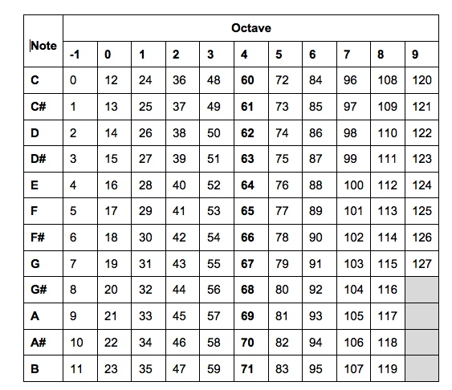
MIDI Note Chart

Slide 6
Some Basic Music Theory
Whole/Half step pattern for a major scale: W-W-H-W-W-W-H.
MIDI notes are represented by integers. A difference of 1 is corresponds to a half step.
The MIDI value for middle-C(C4) is 60. What are the MIDI values for a C major scale?
We represent the notes of a scale using scale degrees: 1-2-3-4-5-6-7
We can create a chord by combining 3 notes. The most common chords start on scale degrees 1, 4 and 5
I chord: 1-3-5. IV chord: 4-6-1. V chord: 5-7-2
Common chord progression is I-IV-V-I

Slide 7
Creating a Note object
An object of the class Note needs a channel, pitch, velocity and length(in milliseconds)
For now, assume we will always be on channel 0. So creating a note object will look like this
Note myNote = new Note(0, pitch, velocity, ticks);
Velocity can be a value between 0-127. How would we will in the statement above to create a note object with a pitch of C4 that has maximum velocity and lasts half a second?

Slide 8
Playing a Note
So far, we have created a MidiBus object and a Note object. Now, lets combine them to actually play a sound!
We will use the sendNoteOn() function, which is a part of the MidiBus class. It takes in a note object as a parameter
myBus.sendMessage(myNote);
This will play our note through the computer speaker!
There is one more thing we have to consider…delay! If we want to play several notes in a row, we need to tell our program to wait for the 1st note to finish before starting the next. The delay function delays the program for a specified number of milliseconds
delay(length);

